Slide 1
ULTRA Lexical items as processes, not atoms Syntax as timing, not geometry
David P Medeiros
University of Arizona
October 7, 2016
Linguistics Conference at University of Georgia-Athens

Slide 2
Overview
Background
Word order: *213 and stack-sorting
Addressing some controversies
Syntax beyond the cycle: SEM
FAQ

Slide 3
Overview
Background
Phrase structure & transformations
Words
Grammars & parsers
Word order: *213 and stack-sorting
Addressing some controversies
Syntax beyond the cycle: SEM
FAQ

Slide 4
Not just phrase structure: transformations
Early in his career, Chomsky demonstrated that phrase structure (IC analysis) was inadequate as a description of sentences.
Transformations were necessary.
Conclusion: one needs phrase structure AND transformations.
In Merge, he has returned to a view of syntax as PS only. Apparent transformations are an illusion of structure-building plus suppression of copies.
Internal Merge

Slide 5
Transformations without phrase structure
I think Chomsky was right the first time
but didn’t go far enough.
Transformations are not only necessary, but also sufficient.
What could it mean to have transformations without phrase structure?
After all, transformations are understood as mapping phrase structure to phrase structure.

Slide 6
ULTRA: transformation without phrase structure
In this talk, I describe ULTRA, the Universal Linear Transduction Reactive Automaton.
A parser-is-grammar theory with transformations, but without phrase structure.
No phrase structure: surface and inner forms of language are (locally) linear and concatenative.
Transformation is linear transduction: mapping a sound string to memory, and thence to a meaning string.
Phrase structure is a kind of dynamic illusion woven by transductions.
Not abstract geometry, but a matter of timing in parsing.

Slide 7
What is syntax about, if not constituency?
But the part-whole relations of sentences are a sine qua non of syntax.
As we all know, sentences aren’t just strings of words; they have hidden internal structure.
Infinite generative capacity requires recursion, which constituency describes.
Conclusion: there needs to be some recursion.

Slide 8
Recursion is a thing doesn’t mean recursion is the only thing.
Of course I agree: there is (some) recursion in language.
But it doesn’t follow that everything is recursion, ‘all the way down’. (Merge)
I claim recursion is a very limited phenomenon, embedding one syntactic cycle (noun phrase, clause) in another.
But inside syntactic cycles, what we think of as tree structure is something else.

Slide 9
What are words?
In generative grammar, words are atoms of phrase structure, points of sound-meaning linkage in an abstract, atemporal expression.
In ULTRA, words link sound and meaning, not as points, but as processes with extent in time.
These lexical processes begin when a word is perceived and stored in short-term memory, and end at the point when its meaning is retrieved for interpretation.
Storage and retrieval are governed by a simple, universal algorithm. And these word-by-word steps yield what looks like phrase structure (but isn’t).

Slide 10
Grammars and parsers
After early enthusiasm (esp. the Derivational Theory of Complexity), linguists nowadays distinguish parsers from grammars.
But see Phillips (1996, 2003).
Fodor (1978) grants the appeal of identifying them:
“PGO [performance grammar only – DPM] theory enters the game with one powerful advantage: there must be psychological mechanisms for speaking and understanding, and simplicity considerations thus put the burden of proof on anyone who would claim that there is more than this.” (Fodor 1978: 470)
But she rejects the idea, reasoning that movement is perverse for parsing, and must reflect a grammar with orthogonal goals.
ULTRA avoids this objection: movement (transduction) isn’t a perversion (of more basic phrase structure mechanisms); it is the basic mechanism.

Slide 11
Where we’re headed
Chomsky: “Linear order does not enter into CI.”
Merge, building unordered sets, expresses this indifference to surface order
I sympathize: surface word order is largely irrelevant to meaning; OV = VO
BUT saying surface order (mostly) isn’t meaningful…
Doesn’t mean meaning itself isn’t a (distinct) linear order.
As Starke, Jayaseelan, Adger have noted, the cartographers’ base hierarchies are simply sequences.
In ULTRA, interpretation sequences are—like word order—an ordering in time, not in (abstract) space.
An output of a universal perceptual algorithm, decoding and compiling word order into meaning order.

Slide 12
Overview
Background
Word order: *213 and stack-sorting
Universal 20
Stack-sorting
Brackets & labels
Why Harmonic orders are special
Syntax beyond the cycle: SEM
FAQ

Slide 13
Syntax should say something about word order.
“An ultimate theory of the syntax of natural languages must contain a theory of word order, specifically, of linguistically possible and impossible hierarchy-order relations.”
(Abels 2016: 179)

Slide 14
Greenberg’s Universal 20
“When any or all of the items (demonstrative, numeral, and descriptive adjective) precede the noun, they are always found in that order. If they follow, the order is either the same or its exact opposite.’’
(Greenberg 1963: 87)
Much subsequent work (Hawkins, Dryer, Cinque) has refined the descriptive details.
According to Cinque (2005), only 14 of 24 possible orders of {Dem, Num, Adj, N} are found.

Slide 15
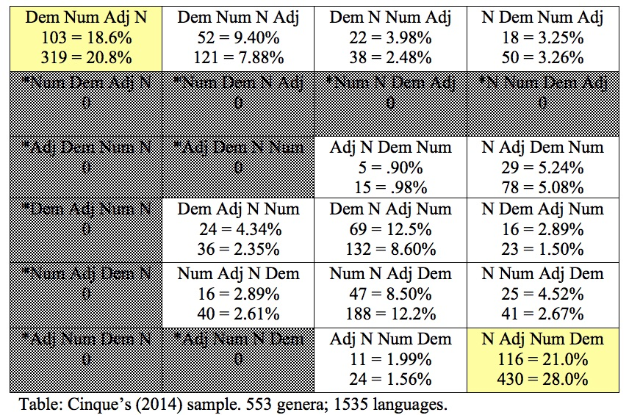
Largest DP order survey: Cinque 2014
K
Notes:
Cinque, of course, isn’t just interested in collecting numbers; he has a theory of why only these orders.

Slide 16
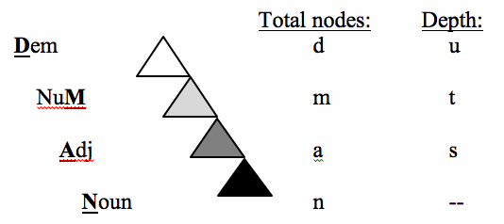
Dem > Num > Adj > Noun
Cinque (2005): movement in the DP affects NP, or XP properly containing NP (no head or remnant movement), in a universal base.

Slide 17
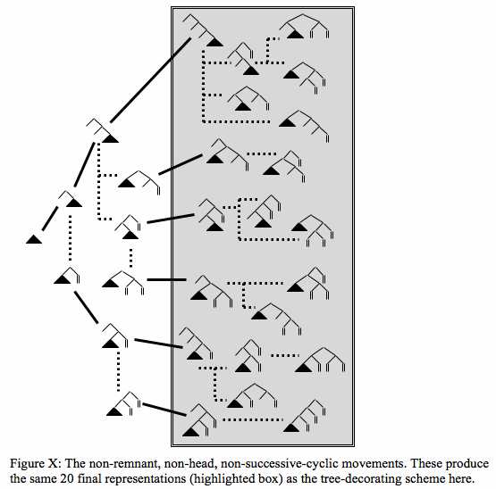
Notes:
Collects all possible derivational steps into one bifurcating diagram. Bold lines are external Merge; dashed lines Internal Merge.

Slide 18
Upshot: 213-avoidance
Cinque’s scheme rules out remnant movement.
What we get: Permutations avoiding 213,
where 1 is hierarchically higher than (i.e. c-commands) 2, etc.
All unattested noun phrase orders contain 213-like subsequences (e.g., *2314)
(213 not necessarily contiguous, either in surface order or interpretation)
What’s ruled out: a …mid…high…low… sequence

Slide 19
Stack-sorting
Knuth (1968) described a very simple procedure for sorting a list of numbers.
Stack-sort: input list is transformed to output list with aid of last-in, first-out memory stack.
Compare top of stack to
next symbol in input
Pop stack to output until
input is larger, then push input to stack.
The algorithm correctly sorts some sequences, but not others.

Slide 20
Syntactic Stack-sorting algorithm
While input is non-empty,
If I > S, Push.
Else Pop.
While Stack is non-empty,
Pop.
I: next element in surface order.
S: element on top of memory stack.
>: a > b if a is deeper in the cartographic hierarchy than b (e.g., N > Adj > Dem).
Notes:
Form-meaning mapping

Slide 21
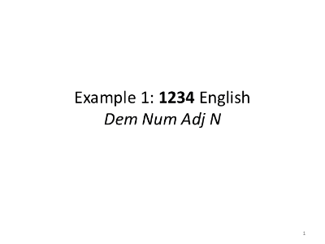

Slide 25
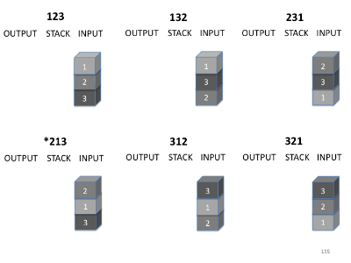
213-avoidance

Slide 26
123
132
231
OUTPUT
STACK
INPUT
OUTPUT
STACK
INPUT
OUTPUT
STACK
INPUT
✔
✔
✔
1
1
1
2
2
2
3
3
3
*213
312
321
OUTPUT
STACK
INPUT
OUTPUT
STACK
INPUT
OUTPUT
STACK
INPUT
✖
✔
✔
1
1
1
3
2
2
2
3
3

Slide 27
Dem Adj N
Dem N Adj
Adj N Dem
OUTPUT
STACK
INPUT
OUTPUT
STACK
INPUT
OUTPUT
STACK
INPUT
✔
✔
✔
D
D
D
D
D
A
A
A
A
N
A
N
N
N
N
A
N
D
*Adj Dem N
N Dem Adj
N Adj Dem
OUTPUT
STACK
INPUT
OUTPUT
STACK
INPUT
OUTPUT
STACK
INPUT
✖
✔
✔
D
A
D
N
D
N
N
D
A
D
A
A
A
N
N
A
N
D

Slide 28
SOV
SVO
OVS
OUTPUT
STACK
INPUT
OUTPUT
STACK
INPUT
OUTPUT
STACK
INPUT
✔
✔
✔
S
S
S
S
S
O
O
O
O
V
O
V
V
V
V
O
V
S
*OSV
VSO
VOS
OUTPUT
STACK
INPUT
OUTPUT
STACK
INPUT
OUTPUT
STACK
INPUT
✖
✔
✔
S
O
S
V
S
V
V
S
O
S
O
O
O
V
V
O
V
S

Slide 29
S, O, V
WALS Feature 81a, “Order of Subject, Object, and Verb” has entries for 1377 languages.
For languages with one dominant order, we have:
SOV: 565 123
SVO: 488 132
VSO: 95 312
VOS: 25 321
OVS: 11 ?231
?*OSV: 4 *213

Slide 30
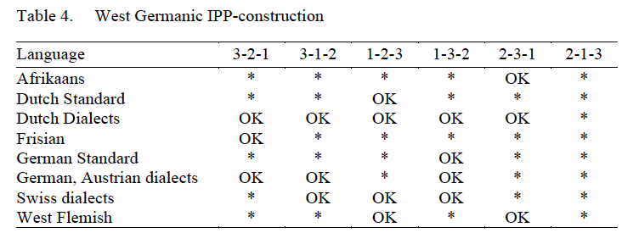
Verb clusters
Wurmbrand (2015:12) lists 5 types of verb cluster constructions: “double modal constructions, two types of auxiliary-modal constructions, modal-auxiliary constructions, and double auxiliary constructions.”
(( (Wurmbrand
2015: 32)
“First, of the six possible combinations involving three verbal elements, five orders are robustly attested. One order, the 2-1-3 order, however, is highly infrequent, perhaps impossible, as an order in verb clusters […].” (Wurmbrand 2006: 14)

Slide 31
*213
As we have seen, there are a number of word order phenomena described by 213-avoidance.
The stack-sorting algorithm, used for parsing, captures this constraint.
While assembling all 213-avoiding orders into their universal bottom-up order of composition.
In real-time, with no autonomous syntactic module, or parameterization.

Slide 32
What have we done?
Stack-sorting captures all of the following:
Linearization: many-to-one mapping of surface orders to meanings
Displacement: non-contiguity of composed elements
Composition: output of sorting
Brackets: sorting operations
Labels: things-sorted by bracket operation

Slide 33
Brackets: serial processing operations
I propose a different understanding of syntactic brackets, rooted in real-time processing:
a left bracket marks the recognition of the category of an item and its storage in temporary memory; (PUSH)
a right bracket marks the retrieval of that item and its integration into a thematic compositional structure. (POP)

Slide 34
Brackets and labels
Stack-sorting implicitly assigns surface structure brackets.
Which, by their nature, are necessarily associated with a particular linguistic element (their label).
Zero-search, unambiguous
The bracketing is very similar to that described by Merge… but not identical.
Where it differs: the present model discards unwarranted structural ambiguity.

Slide 35
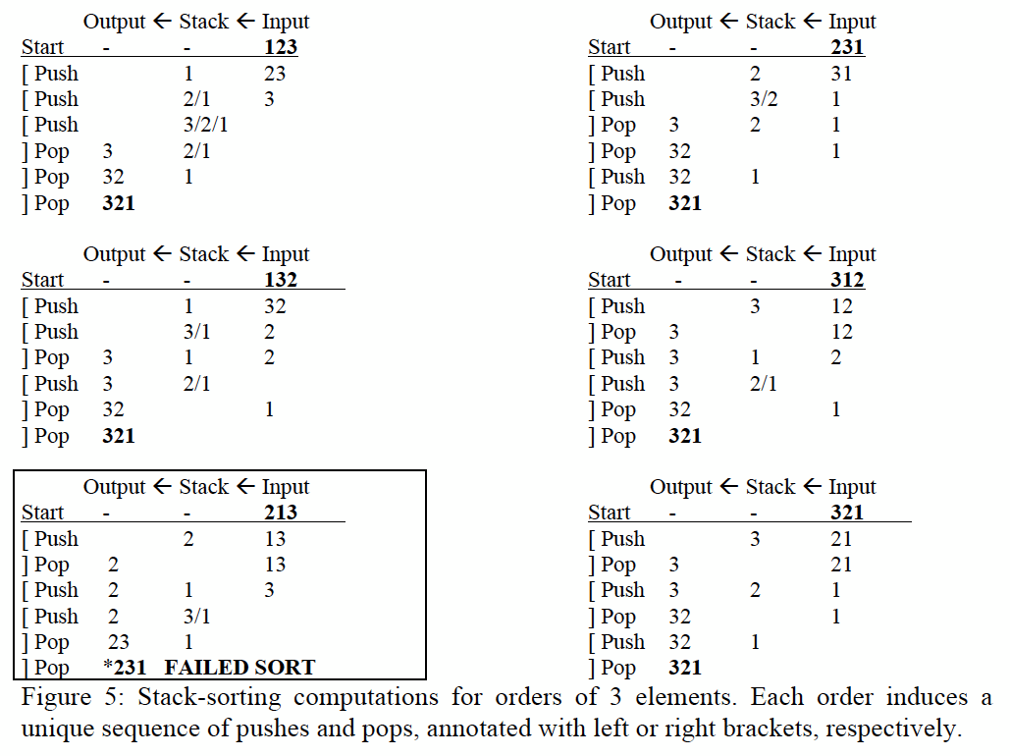
Trees are hiding in this computation

Slide 36
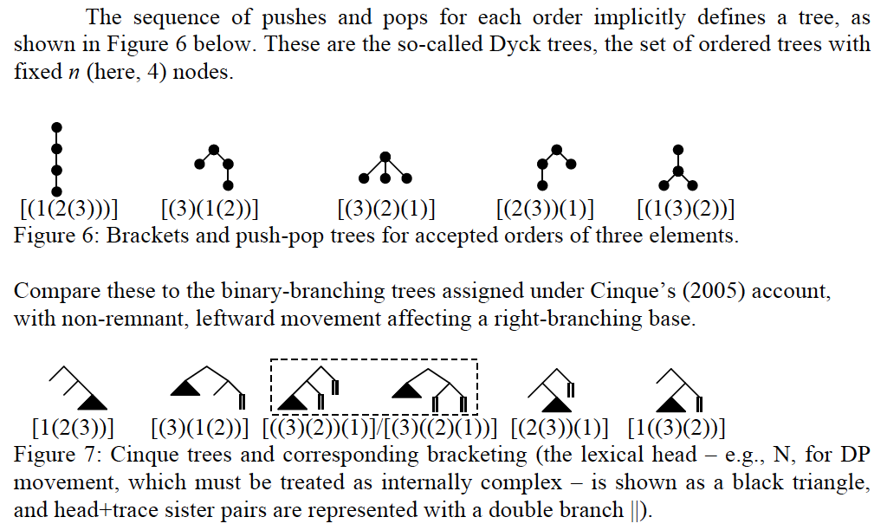
Here they are:
H

Slide 37
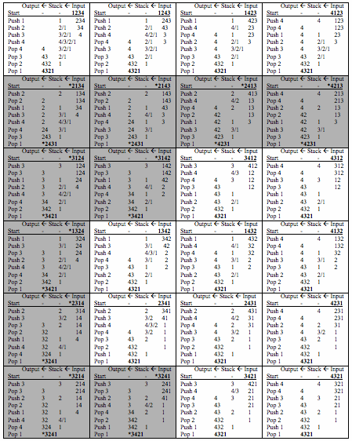
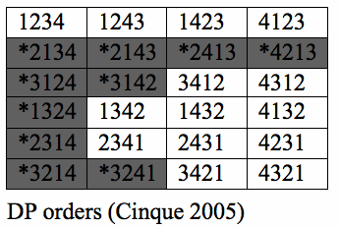

Slide 38
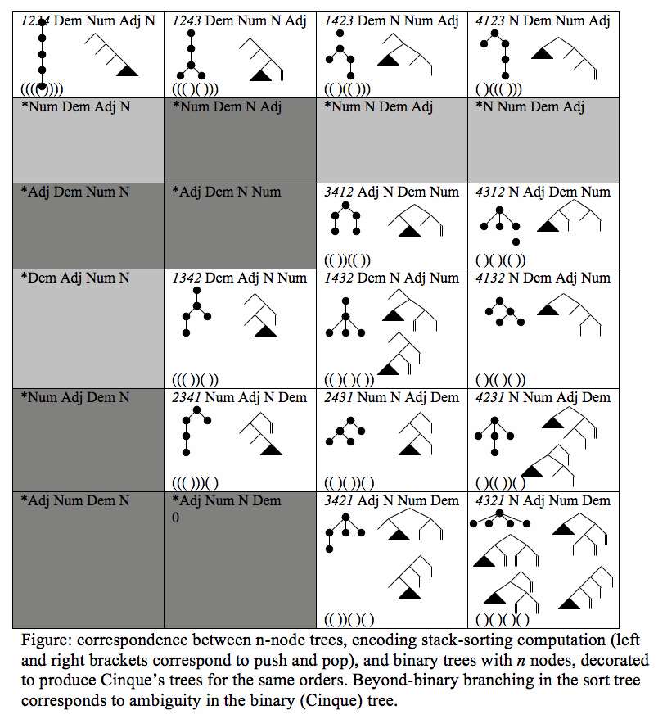
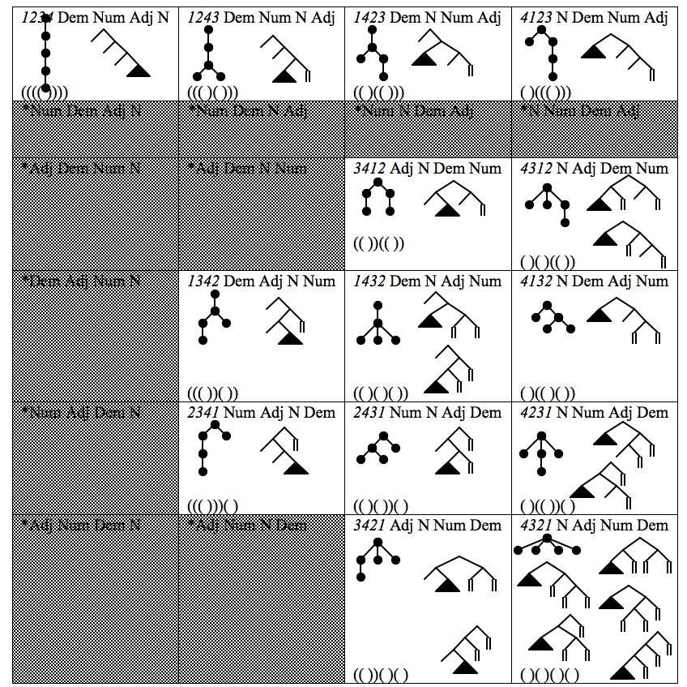

Slide 39
One or many flavors of 4321 order?

Slide 40
Why is the ULTRA account better?
The ULTRA account gets the *213 word order facts:
with a universal and unparameterized parser,
with linearization and composition the same real-time process,
while eliminating spurious structural ambiguity.
Other accounts of U20 and 213-avoidance (Cinque 2005, Steddy & Samek-Lodovici 2011, Abels & Neeleman 2012) all have:
language-particular learning of movement features or alignment constraints (so within-language freedom of order is a problem),
linearization mechanisms separate from abstract structure-building (Merge),
Structural/grammatical ambiguity for some orders.

Slide 41
Why 123 and 321 are special
While 213-avoidance seems to characterize possible word orders, some are much more common than others.
Harmonic orders (123 and 321) predominate. Why?
Not a typological accident; these orders are easiest in AGL too (Culbertson et al 2012; Culbertson & Adger 2014).
321 is easy to justify:
the surface order just is the interpretation order;
one doesn’t need memory at all to parse it.
Something special about 123 order too: once the head 3 is reached, the output order of 1 and 2 is independently enforced by the stack.
Not so for 231, 132, or 312 orders, where one must know the cartography to properly sort the 1 and 2.
For a child learning a 123 order, stack memory enforces the right interpretation order.

Slide 42
Overview
Background
Word order: *213 and stack-sorting
Addressing some controversies
A Universal parser must over-generate
Reaction & prediction
What about Generalized Left-Corner Parsing?
Incrementality as hyperactivity
Universality of bottom-up order
Syntax beyond the cycle: SEM
FAQ

Slide 43
A Universal Parser
ULTRA is intended as a universal parser.
Its goals are both more and less ambitious than standard theories of grammar:
It must apply without alteration to extract the correct interpretation from the surface forms of all languages
It must, therefore, over-generate with respect to particular languages.
Something else must describe differences between languages.

Slide 44
Two systems: reactive and proactive
A core idea is that language comprehension involves dual systems of control:
A reactive control mechanism – bottom-up, input-driven, context-independent, backward-looking.
A proactive control mechanism – top-down, expectation-driven, context-dependent, forward-looking.
Braver, Gray, Burgess (2007); Huettig and Mani (2016)

Slide 45
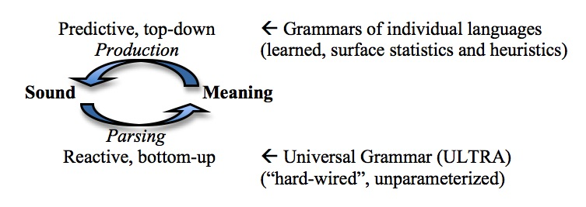
Sound-meaning loop

Slide 46
Division of labor
Reactive Control
Proactive Control
Perception-parsing
Identified with UG (ULTRA)
Automatic, unparameterized
Nearly non-configurational
Builds local structure
Mechanically assigns structure and interpretation
Production-prediction
Identified with individual adult languages
Statistical learning of predictable patterns
Resolves cycle-embedding ambiguity
Selects a handful of universally-available orders
Notes:
Frazier & Fodor 1978: preliminary phrase packager, sentence structure supervisor.
Suggests adults, at some level, ought to discriminate 213 orders from others, regardless of native language. Culbertson and colleagues have very interesting results supporting this idea.

Slide 47
Predictive learning and pro-drop
Pro-drop phenomenon illustrates the dual architecture.
Availability of pro-drop tends to go with rich agreement.
But richness of agreement is not a parameter from which pro-drop follows by law:
some languages with rich agreement do not drop arguments,
while some languages with no agreement do (e.g., Mandarin) .
Experience of the local language must determine this property, a matter of learning in the prediction-production system to which a universal parser is indifferent.
And supplying missing arguments is where we expect a mechanical, bottom-up parser to be supplemented by context-informed predictions.

Slide 48
An aside on GLCP
Computational linguists: bottom-up/top-down is a false dichotomy.
Demers (1977) introduced Generalized Left-Corner Parsing (GLCP)
In which bottom-up and top-down parsing are points on a spectrum
Distinguished by where the “announce point” for a grammar rule is.
S → *NP VP (top-down)
S → NP VP* (bottom-up)
In practice, parsers often fall somewhere in between
S → NP*VP (left-corner)
See Hale (2014) for discussion.
But this does not apply to ULTRA
Because there are no “grammar rules” in the relevant sense!

Slide 49
Controversy
As a real-time comprehension model, the system is “pedestrian” in Stabler’s (1991) sense, within each local cycle.
Local interpretation is bottom-up, starting at the lexical root (verb or noun)
This conflicts with strong evidence for word-by-word incrementality in comprehension.
Especially in the visual world paradigm (e.g., Tanenhaus & Trueswell 2006)

Slide 50
A hyperactive pedestrian
In ULTRA, violations of the pedestrian bottom-up order of composition are not due to incrementality,
but to hyperactivity in Momma, Slevc, & Phillips’ (2015) sense.
Comprehension can “skip ahead” if a root position is posited in advance (by the production-prediction system).
The… (N)
The green … (N)
“There is growing evidence that comprehenders often build structural positions in their parses before encountering the words in the input that phonologically realize those positions [...]”
(Phillips & Lewis 2013: 19)

Slide 51
Head first, even in head-final lgs
There’s some evidence for a universal order of interpretation in parsing, regardless of surface order – the bottom-up order argued for here.
“However, it is probably not the case that mental structure building operations perfectly follow the linear order of a sentence, whether in comprehension or production. To take just one example, in a head-final language such as Japanese it may be necessary for the structure building system to create a position for the head of a phrase before it has completed the arguments and adjuncts that precede the head.” (Phillips & Lewis 2013: 19, emphasis added)

Slide 52
Overview
Background
Word order: *213 and stack-sorting
Addressing some controversies
Syntax beyond the cycle: SEM
Primacy & recency: The Start-End Model
Duality of Semantics
Long-distance movement as intrusion
Root phenomena
FAQ

Slide 53
ULTRA and SEM
What we can do so far:
information-neutral ordering of single domains.
What we still want:
discourse-information effects,
long-distance movement,
recursion.
To get there, we will embed our stack-sorting parser in a well-established model of short-term memory for order, Henson’s (1998) Start-End Model (SEM).

Slide 54
Background: Start-End Model
19265308979
Henson (1998) argues that classic primacy/recency effects come from a dual memory architecture.
Primacy effects reflect a left-edge-anchored gradient, attenuating to the right:
192653…
Recency effects reflect a right-edge anchored gradient, fading to the left:
…308979

Slide 55
Start = queue, End = stack
Very roughly:
The left-edge primacy system is realized by a queue (first-in, first-out access);
The right-edge recency system is realized by a stack (last-in, first-out).
As we will see shortly, this quickly becomes too crude, and a more careful alignment with Henson’s model yields better results.

Slide 56
Start End Model & ULTRA
I propose, as a first approximation, that human parsing is to be explained in terms of “queuing left” and “stack-sorting right”.
The “left periphery” is stored in a separate, lingering memory store,
Meanwhile, the right edge memory system is responsible for building local, “thematic structure” – the base, and its information-neutral permutations.

Slide 57
ULTRA and Duality of Semantics
Left edges and right edges are different in memory.
The first element remains the first, however many follow;
by contrast, each word is a new right edge
I think that explains a few things:
Why the left periphery handles long-distance dependencies, while the right-hand stack system does only local permutation.
Put another way, why leftward movement is unbounded, while rightward movement is not.
And why left peripheral elements are eligible for special discourse-information interpretation, while stack-sorted elements get only thematic compositional interpretation.

Slide 58
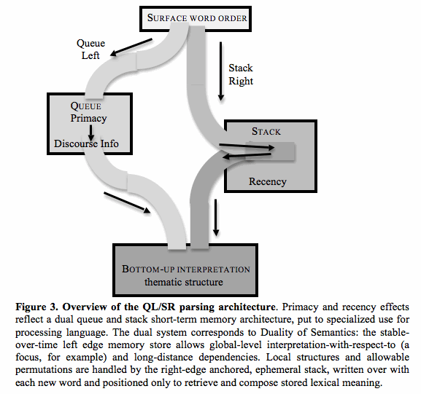
j

Slide 59
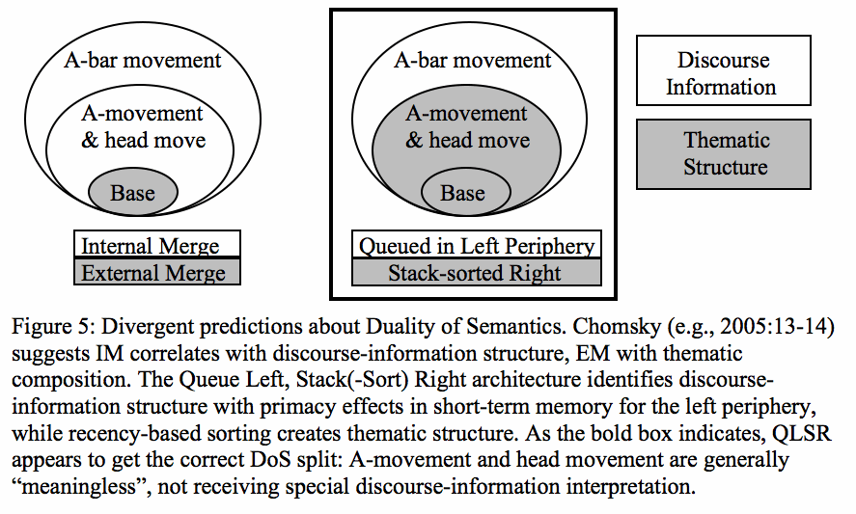
Duality of Semantics

Slide 60
Discourse-information effects: beyond *213
Stack-sorting buys us 213-avoidance
In the parsing of information-neutral single cycles
But 213-like orders are clearly possible:
Bagels, I like
But: special discourse-information status (contrastive focus)
Focus is also involved in 213-like Adj-Dem-N orders in Slavic.
The idea: use of primacy memory allows 213-like orders and explains their special discourse-information status.
Duality of Semantics: primacy in long-distance movement.
Wh-dependencies (examples in FAQ)
Jaminjung discontinuous DPs: express constituent or sentence focus (Schultze-Berndt & Simard 2012)

Slide 61
Contextual grouping: toward recursion
Serial position curves extend beyond recall of items within a single list; similar curves govern accessibility of groups within a series of groups.
“The basic idea behind modeling grouping in SEM is that two dimensions of position are coded. The first is the position of an item in a group; the second is the position of a group in a list. These dimensions are coded with respect to two pairs of start and end markers, resulting in two positional codes for each token.” (Henson 1998: 103; emphasis added, DPM)

Slide 62
Long-distance movement is a kind of “intrusion” effect
In the study of memory for serial order, intrusions are an error in which an item from a grouped list is recalled within the wrong group.
In ULTRA model, long-distance movement amounts to an intrusion in this sense.
An item from an earlier group (cycle),
with high positional salience at the point of recall, and
which has not been suppressed (by retrieval for interpretation),
may be retrieved in the processing of a later group (cycle).
Its group-markers won’t match*, but positional and featural salience may lead to it being cued, as interpretation probes memory for an appropriate item to fill a gap.

Slide 63
LD move as intrusion: islands
The view of long-distance movement as intrusion makes an important prediction:
It should only occur if there’s no better match.
Better match: equivalent featural and positional salience, but with same-cycle group markers.
For example, an as-yet-undischarged left-peripheral element in local group.
That might underlie the wh-island condition and island-hood of relative clauses.

Slide 64
LD move not so intrusive?
Successive cyclicity: there is evidence that fillers are re-activated at the left edge of embedded clauses (Gibson & Warren 2004).
In SEM terms, this may re-code them as part of the current group.
So wh- and relative clause island effects may be better thought of as competition or interference within limited primacy memory.
The point: the first (matrix) clause is special because of enhanced primacy effects.

Slide 65
Primacy and root phenomena
Emonds (1969): root clauses have special syntax unavailable to embedded clauses.
Interestingly, so-called root phenomena usually involve the “left periphery” – and so, primacy.
Heycock (2001) gives the following list:
VP preposing
negative constituent preposing
Topicalization
left dislocation
directional adverb preposing
preposing around “be” and particle preposing
subject auxiliary inversion
direct quote preposing
complement preposing
right dislocation
if-then conditionals
verb-second in Germanic [except Icelandic & Yiddish)
topic markers –wa and –nun in Japanese, Korean.
speaker-oriented adverbials and interjections

Slide 66
Summary
ULTRA: Universal Linear Transduction Reactive Automaton
Syntax = parsing based on linear transduction
UG = reaction; particular languages = prediction
Primacy & Recency = Duality of Semantics?
Recency: Info-neutral stack-sorting 1 cycle
Primacy: left periphery, LD move, root phenomena

Slide 67
Overview
Background
Word order: *213 and stack-sorting
Addressing some controversies
Syntax beyond the cycle: SEM
FAQ
More on wh-movement
SEM is CAM
Ambiguity in ULTRA
Where does cartography come from?
What’s wrong with Merge?
Dyck trees, Cinque trees (& Catalan numbers)

Slide 68
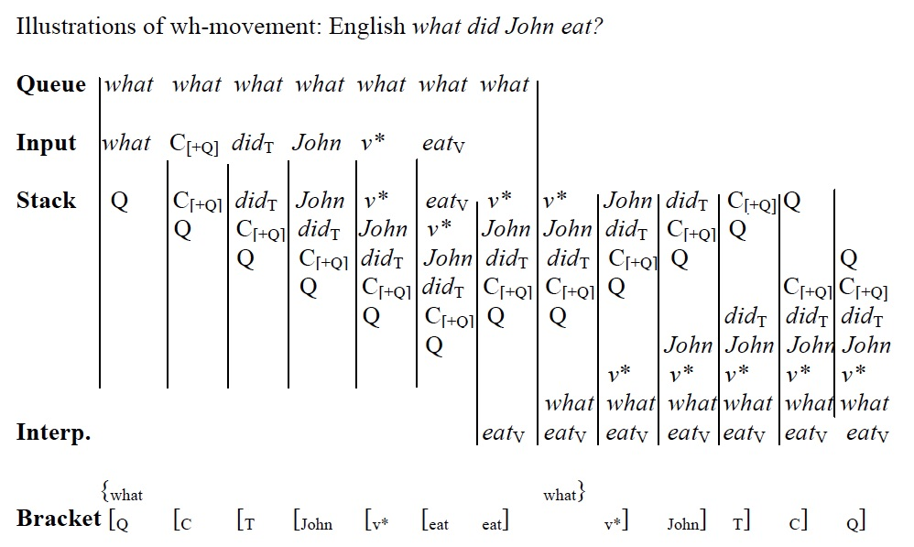
English-type wh-movement
J

Slide 69
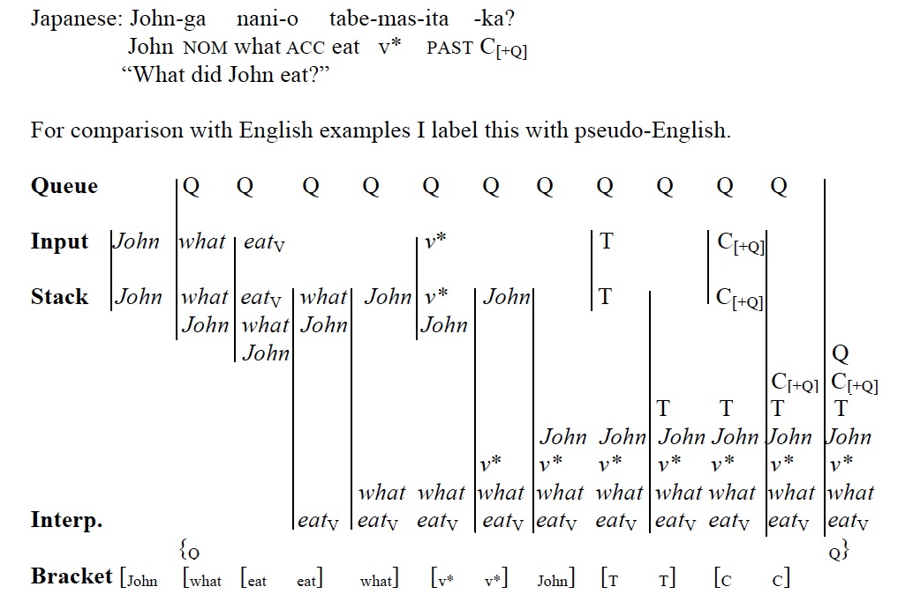
Japanese-type wh in situ
Notes:
We might expect a third possibility, that both thematic and Q portions of the wh-element could be queued. That might offer an analysis of Scrambling, but I won’t explore that here. (talk about anxiety!)

Slide 70
What about wh-in situ?
Something fishy about associating wh-relations with the left periphery: How does wh-in-situ work?
2a. Naoya-ga nanika-o nomiya-de nonda.
Naoya-NOM something-ACC bar-LOC drank
“Naoya drank something at the bar.”
b. Naoya-ga nani-o nomiya-de nonda no?
Naoya-NOM what-ACC bar-LOC drank Q
“What did Naoya drink at the bar?” (Richards 2010: 144)
“[...]there is a domain, starting with the wh-phrase and ending with the wh-complementizer [...], which is characterized by pitch compression[...]” (Richards 2010:145)
“Japanese wh-questions, then, involve a prosodic domain of some type which starts with the wh-phrase and ends with the complementizer.” (145)
Relevant: Some languages have an odd just-left-of-V position for moved wh-items (Basque, Hindi, Hungarian). In the same languages, that position tends to be the exponent of focal stress.

Slide 71
Prosodic salience
“A property of wh-elements which has often been noted is that they have to carry focal stress in order to receive a question word meaning, especially when they stay in situ. Without focal stress, a wh-in-situ receives an indefinite reading.” (Kim 2005, emphasis added)

Slide 72
Memory for serial order in language processing
Indisputable that human short-term memory displays strong primacy and recency effects.
Recency is naturally modeled by a stack memory.
Intriguing connection between
the modality effect: greater recency effects with auditory input, and only with “undegraded speech sounds” (Surprenant, Pitt & Crowder 1993)
and standard use of a stack as parser memory.

Slide 73
Content-addressable memory in language processing
Prominent models of language processing emphasize content-addressable memory (CAM: McElree 2000; Lewis & Vasishth 2005).
This looks like a conflict: we have evidence for two quite different memory mechanisms.
Maybe that’s what we want; see Phillips, Wagers, & Lau (2011) on the different profile of grammatical constraints with respect to interference, taken as a hallmark of CAM

Slide 74
Serial-order-based memory, or CAM?
To put it simply: stack-like memory implies access to elements in memory in a way that is dictated by serial order.
Last-in, First-out
While CAM implies parallel access to all stored elements at once, which compete for retrieval based on cue-matching.
Whenever-in, Best-out

Slide 75
But SEM is actually a form of CAM!
“In brief, SEM assumes that position in a sequence is coded relative to the start and end of that sequence. This positional information is encoded during each presentation and rehearsal of an item, creating an episodic token in short-term memory. The order of items is retrieved by cueing with positional codes for each position of recall and selecting the best matching token.”
(Henson 1998: 81-82)
“Tokens in short-term memory are unordered; their ordering occurs during recall. To recall a sequence, SEM cues each response by reinstating the positional code of the position being recalled. […] This cue is matched against all tokens in parallel.”
(Henson 1998: 85-86)

Slide 76
Positional information as salience modulation in parallel search
An idea: the serial position curve
(factored by Henson into two distinct components),
Effectively measures salience to recall procedures.
Reconstructing serial order in a repetition task is one way of stepping through such memory representations,
when there is no content to be addressed other than order.
But with other retrieval cues available, primacy/recency effects ought to modulate the salience of items in the competition for cue-based retrieval.
So… little new; CAM-based parsing, with a more nuanced theory of positional effects (standard: similarity-based interference, with decay modeling recency).

Slide 77
Multi-dimensional CAM*SEM
We can visualize the situation as follows:
I: Serial position curve (relative height)
II: Match to other cue, e.g. syntactic category (width)
III: Composite salience (positional salience * featural salience)

Slide 78
More 213-avoidance
Abels (2016), citing Pearson (2000), points out that ditransitive structures also disallow *213:
V DO IO (321)
V IO DO (312)
IO DO V (123)
*DO IO V (*213)
A caveat:
This restriction holds only if both IO and DO are DPs.
With IO expressed by a PP, as in to-datives, IO-DO-V (213) order is attested.

Slide 79
Non-unifiable hierarchies?
Verb clusters, and verb-and-arguments, seem to be 213-avoiding.
Abels (2016) illustrates the problem with finding a unified hierarchy:
(9) a. … dass er das Buch nicht hätte lesen sollen.
that he the book not had read should
‘…that he shouldn’t have read the book’
In (9a), we find Obj-Aux-V order, a 213-like order.

Slide 80
Primacy obviates 213 restriction?
Importantly, in (9a) the NP occurs early in its clause.
(9) a. … dass er das Buch nicht hätte lesen sollen.
In earlier formulations of ULTRA, we would say its left-peripheral position gets it queued rather than stacked.
But that isn’t quite right.
Seeing SEM as CAM, the argument wins cue-based competition (for retrieval at interpretation), by
(1) Strong start marker giving high positional salience, and/or
(2) Distinctive category (DP, amid V-stuff) making it independently salient

Slide 81
On ambiguity
Together with the shift in the view of bracketed surface structure comes an alternative view of ambiguity.
In the ULTRA model, ambiguity has two major sources:
lexical ambiguity, here including the possibility for an element to “count as” different positions in the cartographic sequence
And structural ambiguity, which comes about only when multiple phases are in play.
Within each phase—once the identification of elements with the functional sequence is fixed—there is no structural ambiguity.
Thus, structural ambiguity does not exist without meaning ambiguity.
This is crucially different from Merge-based treatments of word order variation like Cinque (2005).

Slide 82
Lexical ambiguity: unlockable
To illustrate lexical-type ambiguity, consider unlockable, famously ambiguous between the meanings “not lockable” and “able to be unlocked”.
On the face of it, this seems a transparent case of ambiguous binary branching.
Three elements can be grouped two ways:
(un+(lock+able))
((un+lock)+able).

Slide 83
Unlockable, cont.
Of course, the ambiguity here turns on (lexical) ambiguity of un– as a verbal or adjectival modifier, with quite different meanings.
Pursuing Merge all the way down,
including a rigid universal order of External Merge,
with surface permutation reflecting movement by Internal Merge even in morphology (Julien, Arregi, Koopman, others),
A modern theorist might draw the following structures, involving movement.

Slide 84
Unlockable: Merge
Base: [un [able [lock]]] Base: [able [un [lock]]]

Slide 85
Unlockable: ULTRA
J

Slide 86
Unlockable: ULTRA

Slide 87
Where does the base order come from?
Syntactic cartography is usually understood as a map of syntactic space.
I argue, instead, that cartography is a map of time—relative timing in the output of the comprehension process.
Exploring the idea that comprehension involves “emulation” – perceptual-motor simulation (Barsalou 2008, Reuschemeyer et al 2010, Feldman 2010, a.o.).
One possibility is that cartographic order recapitulates the order of components of the emulation.

Slide 88
Cartographic sorting ~ emulation programming
The idea: language comprehension “paints a picture in the mind”, in a direct way.
Universal interpretation order corresponds to the order of activation of sensorimotor components.
For example, in the noun phrase, the hierarchy underlying Universal 20 is rendered as the temporal sequence <n/N, Adj, Num, Dem> .
At the bottom of the hierarchy we have the noun, or the ‘little-n’ functional head introducing it. Little-n is associated with noun classifiers, which often involve low-level, gross shape-based features (round, long, etc).
Adjectives prototypically express more structured, therefore “later”, perceptual details: color, texture, etc.
Numeral involves subitization or the approximate number system (ANS), while
Demonstratives seem to encode high-level computations over the domain of discourse.
Cinque (2005) locates quantifiers above all of these; note that Lidz et al (2011) find good evidence that quantifiers like ‘most’ involve a subtraction computation over outputs of the ANS: as we predict, such computations must be later than simple outputs from ANS (Num).
That looks right: quantifiers are at the top of the larger nominal hierarchy Cinque (2005) proposes, corresponding to latest/most complex perceptual computations.

Slide 89
Stack generation 1

Slide 90
Stack generation 2

Slide 91
What’s wrong with Merge?
Motivated as simplest computational operation (in most complex brain; other animals compute)
Multiplies theoretical entities (minimally SM, CI, lexicon, online mapping procedure)
Not an effective computation to support real-time language performance; must be embedded in further layers of performance systems
CI recapitulates derivations
Bad for SM: linearization, copy choice
Bad for CI: chain collapse, labels
Never actually does what it’s supposed to: symmetric combination
EM/IM split doesn’t align with Duality of Semantics
Merge makes cycles (phases) mysterious
Too powerful: can combine anything (must add features to restrain)
But features are too restrictive, no insight into unmotivated movement.
Homunculus theory of hierarchy

Slide 92
The problem of grounding language
“[H]ow can a system such as human language arise in the mind/brain, or for that matter, in the organic world, in which one seems not to find anything like the basic properties of human language? That problem has sometimes been posed as a crisis for the cognitive sciences. The concerns are appropriate, but their locus is misplaced; they are primarily a problem for biology and the brain sciences, which, as currently understood, do not provide any basis for what appear to be fairly well-established conclusions about language.”
(Chomsky 1995: 1-2)

Slide 93
Merge: biolinguistic quintessence
Hauser et al (2002) address the tension between biology and linguistics by positing Merge as the evolutionary innovation behind human language.
Merge is an abstract, atemporal relation, forming the unordered binary set {a, b} from a, b, themselves lexical items or products of Merge.
This operation is thought to be the minimal addition to ancestral cognitive mechanisms necessary to adequately describe syntactic computation.
A fundamentally new cognitive ability.

Slide 94
But the biologists say…
Both Darwin and Lenneberg highlighted the behavioral discontinuity of human language.
But rejected the idea that any fundamentally new ability was involved.
“A discontinuity theory is not the same as a special creation theory. No biological phenomenon is without antecedents.”
(Lenneberg 1967: 234)

Slide 95
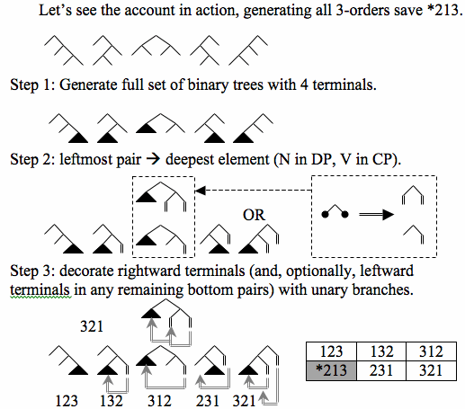
Cinque-style movement trees are a trivial “decoration” of the set of ordered binary trees with fixed number of terminals.

Slide 96
References
Abels, K. (2016). The fundamental left–right asymmetry in the Germanic verb cluster. The Journal of Comparative Germanic Linguistics, 19(3), 179-220.
Abels, K., & Neeleman, A. (2012). Linear asymmetries and the LCA. Syntax, 15(1), 25-74.
Barsalou, L. W. (2008). Grounded cognition. Annu. Rev. Psychol., 59, 617-645.
Braver, T. S., Gray, J. R., & Burgess, G. C. (2007). Explaining the many varieties of working memory variation: Dual mechanisms of cognitive control. Variation in working memory, 76-106.
Chomsky, N. (1995). The Minimalist Program. Cambridge, MA: MIT press.
Chomsky, N. (2005). Three factors in language design. Linguistic inquiry, 36(1), 1-22.
Cinque, Guglielmo. (1999). Adverbs and Functional Heads. A Cross-linguistic Perspective. New York: Oxford University Press.
Cinque, Guglielmo. (2005). Deriving Greenberg’s Universal 20 and Its Exceptions. Linguistic Inquiry 36.315-332
Cinque, Guglielmo. (2014). On the movement account of Greenberg’s Universal 20: Refinements and Replies. Ms., University of Venice.
Culbertson, J., Smolensky, P., and Legendre, G. (2012). Learning biases predict a word order universal. Cognition 122(3), 306-329.
Culbertson, J., & Adger, D. (2014). Language learners privilege structured meaning over surface frequency. Proceedings of the National Academy of Sciences 111 (16), 5842-5847.
Demers, A. J. (1977). Generalized left corner parsing. In Proceedings of the 4th ACM SIGACT-SIGPLAN symposium on Principles of programming languages (pp. 170-182). ACM.
Dryer, Matthew S. & Haspelmath, Martin, eds. (2013). The World Atlas of Language Structures Online. Leipzig: Max Planck Institute for Evolutionary Anthropology. (Available online at http://wals.info, Accessed on 2015-09-18).
Feldman, J. (2010). Embodied language, best-fit analysis, and formal compositionality. Physics of Life Reviews, 7(4), 385-410.
Frazier, L., & Fodor, J. D. (1978). The sausage machine: A new two-stage parsing model. Cognition, 6(4), 291-325.
Gibson, E., & Warren, T. (2004). Reading‐Time Evidence for Intermediate Linguistic Structure in Long‐Distance Dependencies. Syntax, 7(1), 55-78.
Greenberg, Joseph. 1963. Some universals of grammar with particular reference to the order of meaningful elements. In J. Greenberg, ed., Universals of language. 73-113. Cambridge, MA: MIT Press.
Hauser, M. D., Chomsky, N., & Fitch, W. T. (2002). The faculty of language: what is it, who has it, and how did it evolve?. science, 298(5598), 1569-1579.
Henson, R. N. (1998). Short-term memory for serial order: The start-end model. Cognitive psychology, 36(2), 73-137.
Huettig, F., & Mani, N. (2016). Is prediction necessary to understand language? Probably not. Language, Cognition and Neuroscience, 31(1), 19-31.
Kim, S. S. (2005). Focus intervention effects in questions. Theoretical East Asian Languages, 3.
Knuth, Donald. (1968). The Art of Computer Programming Vol. 3: Sorting and Searching.
Lenneberg, E. H., Chomsky, N., & Marx, O. (1967). Biological foundations of language (Vol. 68). New York: Wiley.
Lewis, R. L., & Vasishth, S. (2005). An activation‐based model of sentence processing as skilled memory retrieval. Cognitive science, 29(3), 375-419.
Lidz, J., Pietroski, P., Halberda, J., & Hunter, T. (2011). Interface transparency and the psychosemantics of most. Natural Language Semantics, 19(3), 227-256.
McElree, B. (2000). Sentence comprehension is mediated by content-addressable memory structures. Journal of psycholinguistic research, 29(2), 111-123.
Momma, S., Slevc, L. R., & Phillips, C. (2015). The Timing of Verb Selection in Japanese Sentence Production. Journal of experimental psychology. Learning, memory, and cognition.
Phillips, C., Wagers, M. W., & Lau, E. F. (2011). 5: Grammatical Illusions and Selective Fallibility in Real-Time Language Comprehension. In Experiments at the Interfaces (pp. 147-180). Brill.
Phillips, C., & Lewis, S. (2013). Derivational order in syntax: Evidence and architectural consequences. Studies in Linguistics, 6, 11-47.
Rueschemeyer, S. A., Lindemann, O., van Rooij, D., van Dam, W., & Bekkering, H. (2010). Effects of intentional motor actions on embodied language processing. Experimental psychology.
Richards, N. (2010). Uttering trees (Vol. 56). MIT Press.
Rudin, C. (1988). On multiple questions and multiple wh fronting. Natural Language & Linguistic Theory, 6(4), 445-501.
Stabler Jr, E. P. (1991). Avoid the pedestrian’s paradox. In Principle-Based Parsing (pp. 199-237). Springer Netherlands.
Steddy, S., & Samek-Lodovici, V. (2011). On the ungrammaticality of remnant movement in the derivation of Greenberg's Universal 20. Linguistic Inquiry, 42(3), 445-469.
Surprenant, A. M., Pitt, M. A., & Crowder, R. G. (1993). Auditory recency in immediate memory. The Quarterly Journal of Experimental Psychology, 46(2), 193-223.
Tanenhaus, M. K., & Trueswell, J. C. (2006). Eye movements and spoken language comprehension. Handbook of psycholinguistics, 863-900.
Wurmbrand, Susanne. (2006). Verb clusters, verb raising, and restructuring. In Martin Everaert and Henk van Riemsdijk, eds., The Blackwell Companion to Syntax, Vol. V, 227-341. Oxford: Blackwell.
Wurmbrand, S. (2015). Verb clusters, verb raising, and restructuring. ling.auf.net/lingbuzz/002433/current.pdf

