Slide 1
Sample stimuli
David P Medeiros, PhD
University of Arizona
Dept of Linguistics

Slide 2
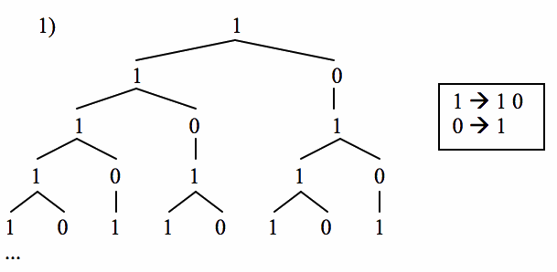
Fibonacci L-grammar
101101011011010110101101101011011010110101101101011010110110101...
http://personal.maths.surrey.ac.uk/ext/R.Knott/Fibonacci/fibrab.qt

Slide 3
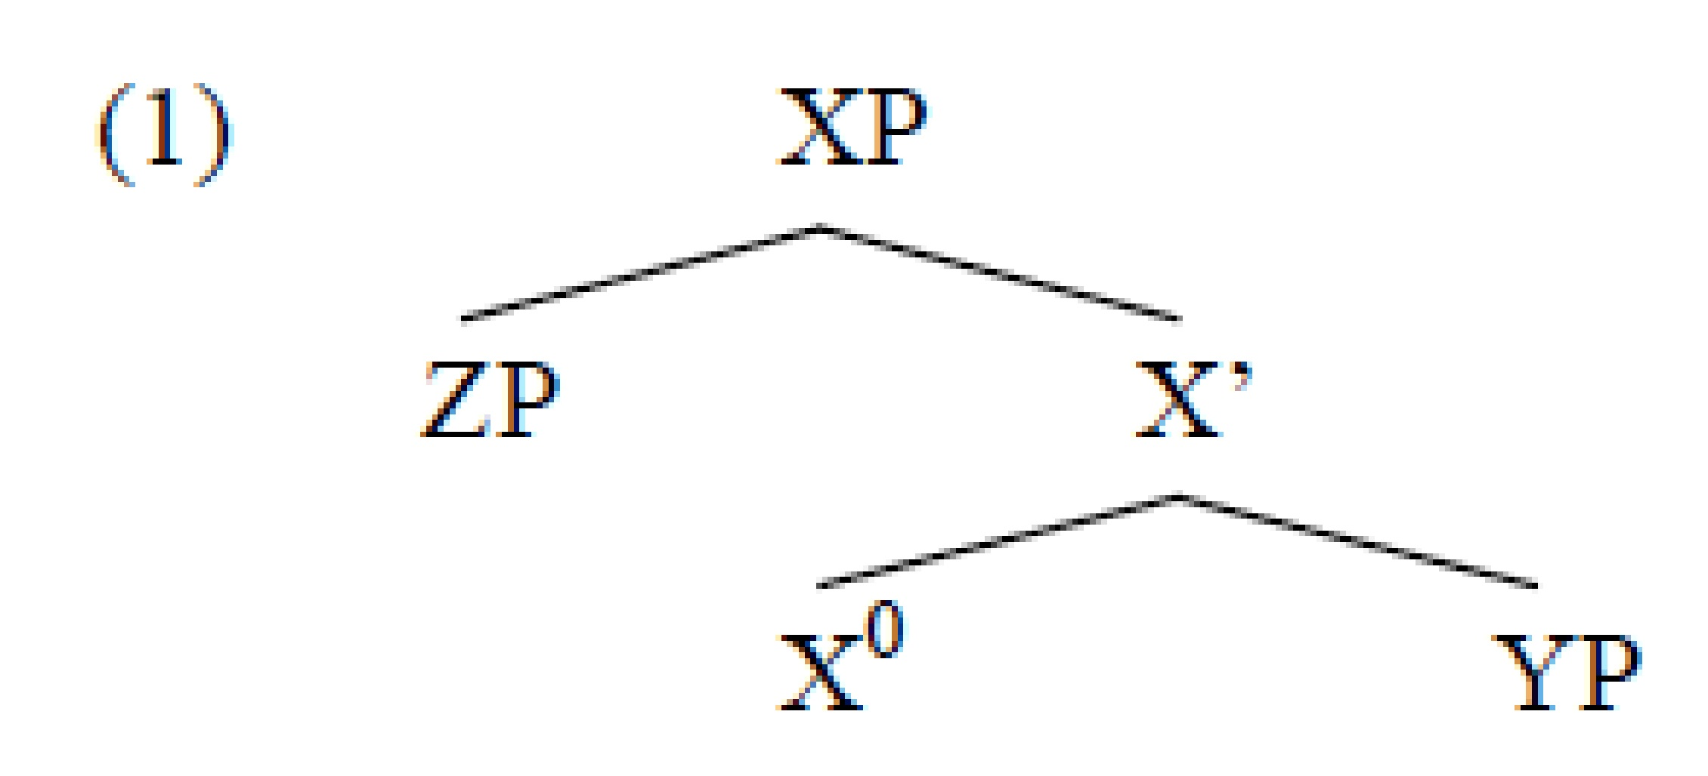
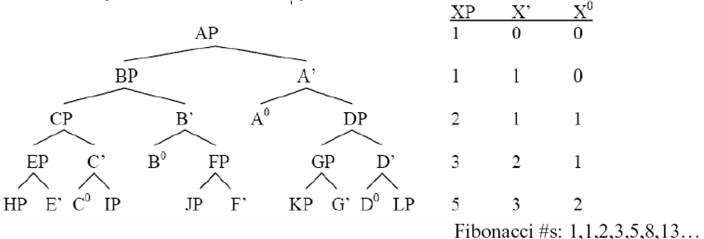
Why is language that way? This structure might follow from more general principles. It is suggestive that the X-bar pattern generates the Fibonacci numbers, which arise in many natural systems.

Slide 4
According to Chomsky & Halle (1968) (see also Bresnan 1971, 1972, Cinque 1993)
The deepest part of a syntactic tree gets maximal stress (Nuclear Stress Rule)...
Reading sequence of stress maxima (black heads) and non-maxima (grey heads) from left to right in an idealized X-bar tree expanded to uniform depth, we get the Fibonacci word:

Slide 5
The Golden String/Fibonacci Word/Rabbit Sequence
This structure is a quasiperiodic binary sequence whose long-range order reflects the mathematics of the Fibonacci numbers.
By “quasiperiodic”, we mean that it never exactly repeats (such sequences are merely periodic), but neither is it random. In fact it is self-similar.
Its linear organization reflects hierarchical groupings of the kind indicated in the tree above.
This structure is reflected in many places in nature, from the organization of spin glasses (Binder 2008), to the oscillations of multiperiod variable stars including UW Herculis (Escudero 2003).

Slide 6
Saddy’s results
J Douglas Saddy and his group at the Centre for Integrative Neuroscience and Neurodynamics,
played subjects a long stretch of this Fibonacci grammar sequence, as a string of ba/bi syllables:
ba bi ba ba bi ba bi ba ba bi ba ba bi...
As well as other sequences, like the Thue Morse (1 → 01; 0 → 10) and Feigenbaum (1→ 10, 0 → 11) grammars
Then had subjects decide which of two short samples played subsequently best matched what they had heard before.
Subjects recognized the Fibonacci sequence more accurately than any other.

Slide 7
Remarkable
This is a remarkable fact; the long-range order of the sequence is strictly beyond the capabilities of finite-state (Markovian) processes to describe.
Even more stunning: in computer science, the Fibonacci word is known to be the worst case for the application of many efficient pattern recognition algorithms (Knuth, Morris, & Pratt 1977, Aho 1990, a.o.).
Whatever the reason for subjects recognizing this string best, it seems it’s not about local statistical regularities (e.g., recognizing n-grams).

Slide 8
Some L-grammars of interest over a binary alphabet
Sqrt-2 sequence (cutting sequence; binary alphabet but not binary-branching)
Feigenbaum L-grammar
Thue-Morse sequence (XOR grammar)
Random binary sequence

Slide 9
Fib L-grammar and variants
True Fibonacci word (Golden String)
Pseudo-random Fib (101, 10110 substituting for 0, 1 in random string)
Pulsations of UW Herculis, as reported by Escudero (2003)
Free linearization Fib sequence (0 → 1; 1→10/01 at random)
Lucas sequence

Slide 10
Binary-branching L-grammars over a ternary alphabet
Random
Tribonacci (Endocentric, Pisot, cutting sequence)
Heptagon (Polygonal)
Heptagon-b (Polygonal)*
Pisot 1.46 (Pisot)
The two Heptagon sequences differ in terms of how the intermediate non-terminal is
linearized. For root nonterminal r, the rewrite rule for the root must be r → r i, in that order,
for the system to yield ever-longer portions of a single infinite sequence. Linearizing the non-
terminal that occurs hierarchically closest to the root first yields the canonical Tribonacci
word, and I have kept to this convention elsewhere. However, the alternate linearization for
this system yields a string that is a much better n-gram match for the Pisot 1.46 system

Slide 11
L-grammars realized as sequences of tones rather than syllables
In a pilot study, Saddy obtained very similar results to those he got with his syllabic stimuli, using tones.
Fib word as tones
Random binary tones
Tribonacci word as tones

Slide 12
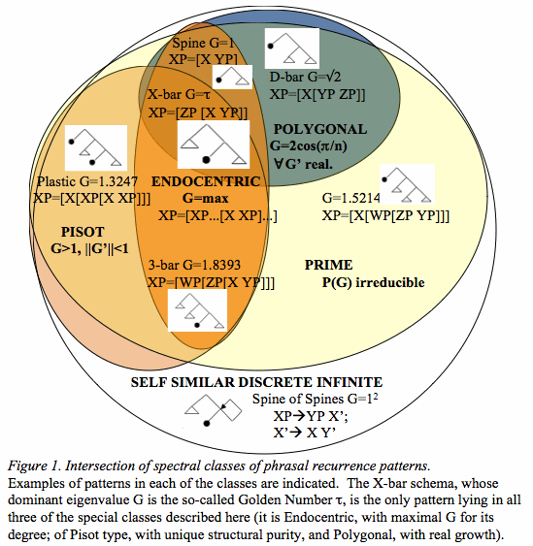

Slide 13
Background
Following up on Saddy’s results:
The “fibonacci word” 101101011011010110...
is best recognized by subjects.
We will test some ideas about why the Fibonacci word is so special.
By probing other sequences with some but not all of its special mathematical properties,
we aim to discover which properties, if any, predict distinctive behavioral responses.

Slide 14
Proposed Methods
For the initial phase, we will gather reaction time data with the use of clickers.
The stimuli consist of two sequences spliced together into a single computer-generated stream of syllables, without any overtly signaled transition.
The task is to press the clicker as soon as the subject detects a change in the pattern.

Slide 15
Interpretation
We expect that the fastest and most accurate reaction times will be for transitions between well-recognized sequences and randomness.
We expect that some sequences will “entrain the brain” less strongly, or not at all, and subjects will be slower and less accurate in detecting transitions to/from such patterns.

Slide 16
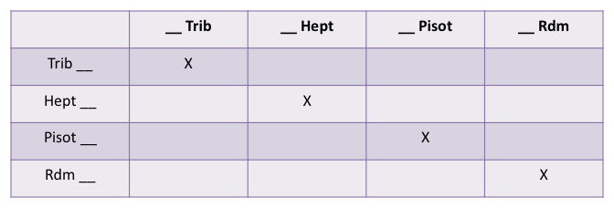
34 second samples; splice @ 17 seconds
We also want to examine self-similar sequences generated by L-grammars lacking any of these special properties, but no such binary-branching discrete infinite systems are found over three symbols. We may try a cutting sequence at some irrational angle as a control.

